Slide 1
Divine Group
The Artisans of Cloth
List of sister Concerns of Divine Group;
Divine Textile Limited.
Divine Textile Limited. (Unit-2)
Divine Fabrics Limited.
Chawgacha Fashions Limited.
Divine Garments Limited.
Divine Spinning Mills Limited.
Divine Packaging Limited.
Divine Cold Storage Limited.
Divine Agro Tissue Culture Limited.
Divine Feed Mills Limited
Divine Center Limited.
Dr. Anisuzzaman Hospital Limited.

Slide 2
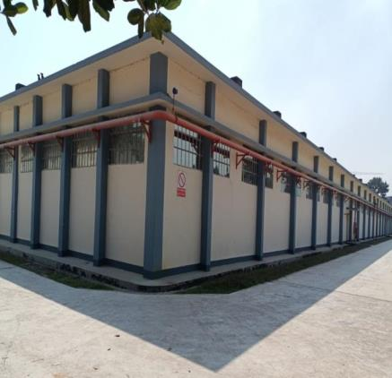
Welcome To Divine Spinning Mills Limited
Spinning process is the first step to produce textile layout such as garments, fabric, home textile, and so on. Originally, textile Fibers were spun into yarn by hand using a spindle whorl. But now this has been replaced by advanced technology of mechanical spinning carried out in spinning mills today.
Born solely out of the need to ensure best quality and accuracy, Divine Spinning Mills Ltd. is the backward linkage of Divine Textiles Ltd. It was launched in Jun-2017 with state of the art equipment.
Let’s have a view of the spinning process in Divine Spinning Mills Ltd.
Notes:
Spinning process is the first step to produce textile layout such as garments, fabric, home textile, and so on. Originally, textile Fibers were spun into yarn by hand using a spindle whorl. But now this has been replaced by advanced technology of mechanical spinning carried out in spinning mills today.
Born solely out of the need to ensure best quality and accuracy, Divine Spinning Mills Ltd. is the backward linkage of Divine Textiles Ltd. It was launched in Jun-2017 with state of the art equipment. Let’s have a view of the spinning process in Divine Spinning Mills Ltd.

Slide 3
Management
Divine Group believes in consistently improved quality production. To stand on it, Divine Group combined the whole family in a single work-frame, where everyone is equally responsible for their job. Let us look at Divine Group Ltd family.
S. No | Name of the Directors | Designation
1 | Fatema Zaman | Chairman
2 | Md. Hasanuzzaman | Managing Director
3 | Saif Hassan | Director
4 | Samaya Hassan | Director
5 | Rifat Haider Niloy | Director

Slide 4
Our Team
We come together, work together, share together, Learn together, Grow together.
Our team is highly experienced professionals which helps us to supply the high quality processing range to our customers in a best possible manner.
Some of the professional we have are: » Technical experts » Quality analysts
» Administration personnel
» Marketing personnel » Engineers » Managers

Slide 5
Short Overview
Name of the project | Divine Spinning Mills Limited
Head Office | House # 348, Road # 26
 | New DOHS Mohakhali
 | Dhaka, Bangladesh.
Factory | Kewa, Sreepur
 | Gazipur, Bangladesh
Type of the project | Yarn manufacturing
 | Industries under Textile Sector.
Employee Generation | 720
No. of Spindles | For Ring Spinning 24000 Spindles
 | For Rotor Spinning 400 Spindles
Production Capacity | Ring Spinning : 12500 Kg’s/Day
 | Rotor Spinning : 3000 Kg’s/Day
Total Factory Pace | 182777 Sft.

Slide 6
Policies
Human Resource Policy
Recruitment Policy
Anti-Corruption/anti-bribery Policy
Training Policy
Disciplinary Action Policy
The Rights of Freedom of Association and Collective Bargaining Policy
No Discrimination Policy
Compensation and Benefits Policy
Working Hour and Leave Policy
Occupational Health and Safety Policy
Child Labor Policy
Forced Labor Policy
Environment Policy
Prohibition of Harassment & Abuse Policy
Custom Compliance Policy
Security Policy
Overtime Policy
Grievance Policy
Maternity Benefit Policy
Personal Protective Equipment Use Policy
21. Waste Material Disposal Policy
22. Attendance Bonus Policy
23. Child Care Center Policy
Medical Policy
Female Employee Rights Policy
Welfare Policy
Weight Lifting Policy
Fire Safety Policy
Lockout Tag out Policy
Separation Policy
Anti Smoking Policy
Water Management Policy
Business Ethics Policy
Customer Complain Policy
Disclosure Policy
Cotton Procurement Policy
Social Policy
Sourcing Policy
Compensation & Benefits Policy
Disclosure Policy
Policy On OECD

Slide 7
Training
Training Name | Department | Interval (Month) | No. of Trainings / Year
GOTS | R & D | 3 | 4
 | Production | 3 | 4
 | Maintenance | 3 | 4
 | Electrical
Social Awareness | HR & Admin | 3 | 4
Anti Harassment | HR & Admin | 3 | 4
Health & Safety | HR & Admin (Doctor) | 3 | 4
First Aid Training | HR & Admin (Doctor | 3 | 4
PPE | R & D | 3 | 4
 | Maintenance | 3 | 4
 | Electrical | 3 | 4
Fire Drill | HR & Admin | 3 | 4
Fire Fighting | HR & Admin | 3 | 4
Energy Conservation | Electrical | 3 | 4
Energy Improvement | Electrical | 3 | 4
WPC | HR & Admin | 2 | 6

Slide 8
Achievements
Notes:
Need to add CMIA .

Slide 9
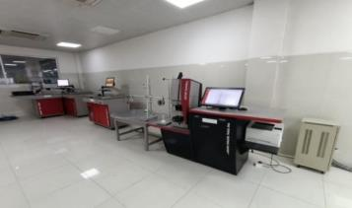
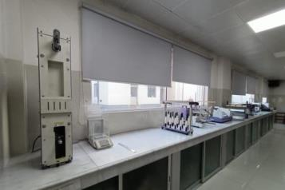
Research & Development
Machine | Brand | Country of Origin
Uster HVI-1000 | Uster | Switzerland
Afis Pro-02 | Uster | Switzerland
Uster Tester (UT-6) | Uster | Switzerland
Uster Auto Sorter (UA-5) | Uster | Switzerland
Autodyn II | Mesdan | Italy
Every step of the manufacturing process starting from cotton Fiber to yarn is checked and standardized according to Buyer expectation. This is achieved through the help of advanced machineries as mentioned above as well as others like Smart Block, Fibro Block, Compu Twist, Auto Wrap, Auto Winder, Elestretch, Digi Moisture, Force Gauge, Digital Troboscope, RH Controller .
The R&D department continuously analyzes, develops, and fine tunes where needed in order to produce yarn of the finest quality.
Notes:
Every step of the manufacturing process starting from cotton Fiber to yarn is checked and standardized according to Buyer expectation. This is achieved through the help of advanced machineries as mentioned above as well as others like Smart Block, Fibro Block, Compu Twist, Auto Wrap, Auto Winder, Elestretch, Digi Moisture, Force Gauge, Digital Troboscope, RH Controller .
The R&D department continuously analyzes, develops, and fine tunes where needed in order to produce yarn of the finest quality.

Slide 10
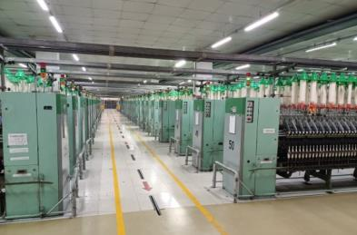
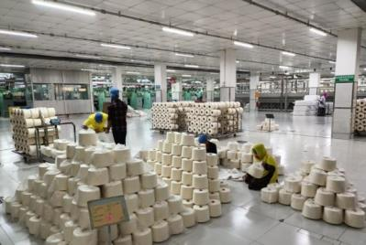
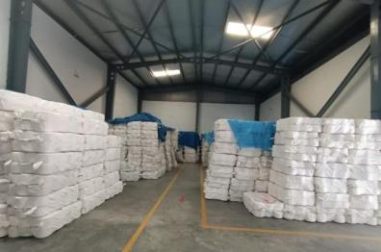
Product Type
Count Range : 8 Ne ~ 40 Ne
7 OE ~ 20 OE
100 % Cotton: Combed yarn, Carded Yarn, Slub Yarn, Compact Yarn, OE yarn.
Production Capacity per Day = 16000 Kg’s.

Slide 11
Production Process
CARD PROCESS DESCRIPTION
Blow Room
Fiber opening. Cleaning micro-dust, trash, dust , short Fiber & separate foreign Fiber.
Carding
To make the Fiber parallel & reduce Neps, short Fiber, trash particles. To produce a Fiber as like ribbon which is called sliver..
Breaker Drawing
To make the Fiber parallel to each other. To improve uniformity of sliver by drafting and doubling.
Finisher Drawing
To further straighten the crimped, curled and hooked Fibers & to achieve uniform weight per unit Length of sliver.
Simplex
Attenuation of drawn sliver to form roving of required count by drafting. To insert small amount of twist to give required strength of roving..
Ring
Feed roving first will be drafted here. Afterwards, twist will be imparted to the yarn thereby giving strength to the Fiber strand. Finally, the resulting yarn is wind up on to the bobbin.
Finishing
To reduce yarn fault like thick, thin, neps, slubs, foreign matter & increase the quality of yarn. Also, make final product ready for packaging.
Heat Setting
To fix and conceal the twist into the yarn. To maintain standard moisture of yarn in order to get desired luster of fabric,
Packing
To make bag of finished yarn for delivery to the next process .

Slide 12
Comb Process Description
Blow Room
Fiber opening. Cleaning micro-dust, trash, dust , short Fiber & separate foreign Fiber.
Carding
To make the Fiber parallel & remove Neps, Short Fiber, trast particles. To produce a Fiber as like ribbon which is called silver..
Breaker Drawing
To make the Fiber parallel to each other. To improve uniformity of sliver by drafting and doubling.
Omega Lap
To make lap from sliver and make it ready for combing process
Comber
To remove Neps in the carded sliver ,remove the Fiber shorter than a predetermined length & remove remaining impurities in the lap
Finisher Drawing
To straighten the crimped, curled and hooked Fibers & uniform weight per unit Length of sliver.
Simplex
Attenuation of drawn sliver to form roving of required count by drafting. Insert small amount of twist to give required strength of roving..
Ring
Feed roving first will be drafted here. Afterwards, twist will be imparted to the yarn thereby giving strength to the Fiber strand. Finally, the resulting yarn is wind up on to the bobbin.
Finishing
To reduce yarn fault like thick, thin, neps, slubs, foreign matter & increase the quality of yarn. Also, make final product ready for packaging.
Heat Setting
To fix and conceal the twist into the yarn. To maintain standard moisture of yarn in order to get desired luster of fabric,
Packing
To make bag of finished yarn for delivery to the next process .

Slide 13
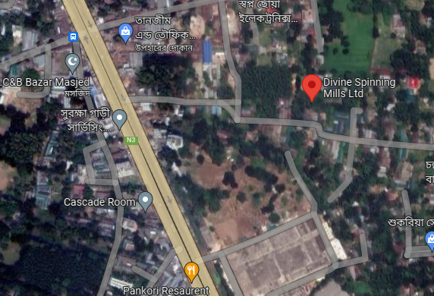
Manufacturing Unit
Head Office: House # 348, Road # 26 New DOHS Mohakhali, Dhaka Bangladesh
Manufacturing Units
Kewa, Sreepur Gazipur Bangladesh

Slide 14
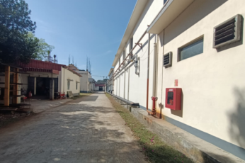
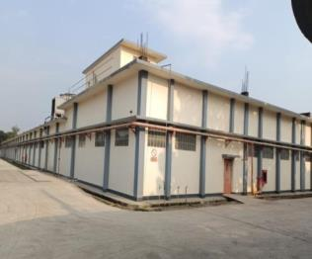
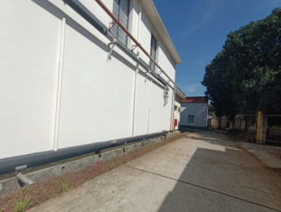
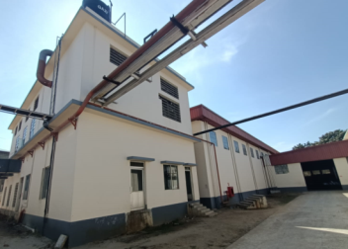
The Factory Building
1 | 4 storied building (Residence)
2 | Semi paka steel trast roofing Building (Store)
3 | 3 storied building (Office Building)
4 | 1 storied building (Production)
5 | Semi paka steel trast roofing Building (Store)
6 | Semi paka steel trast roofing Building (Security Residence)

Slide 15
Machine Profile
Machine | Brand | Country of Origin
Blow Room | Rieter | Switzerland
Carding (C-70) | Rieter | Switzerland
Carding (TC-15) | Trutzschler | Germany
Draw Frame | Rieter | Switzerland
Omegalap | Rieter | Switzerland
Comber | Rieter | Switzerland
Simplex | Toyota | Japan
Ring Frame | Slub attachment (Amsler) | Switzerland
Ring Frame | Compact attachment (Rotorcraft) | Switzerland
Ring Frame | Jingwei | China
Autocone | Murata (Qpro Plus) | Japan
Yarn Conditioning m/c | X-orella | Switzerland
Rotor (R-35) | Rieter | Switzerland

Slide 16
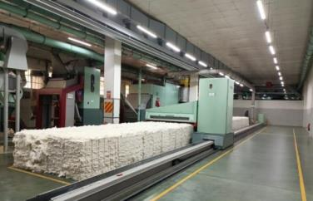
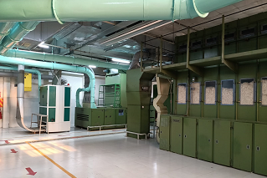
Blow Room
Ring Spinning
Name of Machine | Brand | Country of Origin | Total Qty.
Unifloce | Rieter | Switzerland | 1 set
Uniclean | Rieter | Switzerland | 1 set
Unimix | Rieter | Switzerland | 1 set
Unistore | Rieter | Switzerland | 1 set
Vision sheild | Rieter | Switzerland | 1 set
Condenser | Rieter | Switzerland | 1 set
Rotor Spinning
Name of Machine | Brand | Country of Origin | Total Qty.
Bale Opener | Trutzschler | India | 1 set
Axi-flo | Trutzschler | India | 1 set
Multimixer | Trutzschler | India | 1 set
Separomat | Trutzschler | India | 1 set
Condenser | Trutzschler | India | 1 set
Cleanomat | Trutzschler | India | 1 set
Loptex | Loptex | Italy | 1 set
Dustex | Trutzschler | India | 1 set
Willon Machine | BD | Bangladesh | 1 set

Slide 17
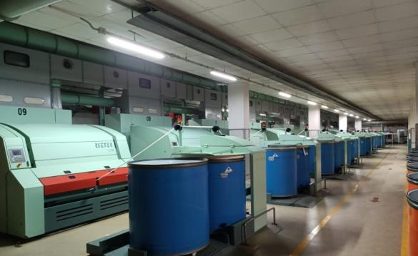
Carding
Ring Spinning
Name of Machine | Brand | Country of Origin | Total Qty.
Rieter Card | Rieter | Switzerland | 9 set
Rotor Spinning
Name of Machine | Brand | Country of Origin | Total Qty.
Trutzschler card | Trutzschler | Germany | 1 set

Slide 18
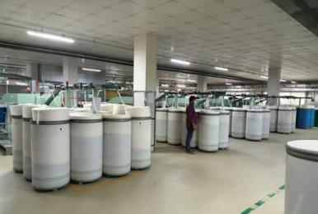
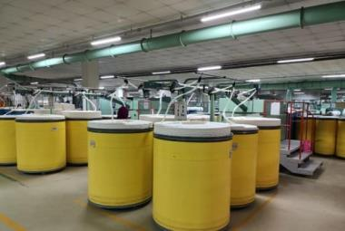
Draw Frame
Ring Spinning
Name of Machine | Brand | Country of Origin | Total Qty.
Breaker Draw Frame | Rieter | Germany | 4 Set
Finisher Draw Frame | Rieter | Germany | 5 Set
Rotor Spinning
Name of Machine | Brand | Country of Origin | Total Qty.
Breaker Draw Frame | Rieter | Germany | 1 Set
Finisher Draw Frame | Rieter | Germany | 1 Set

Slide 19
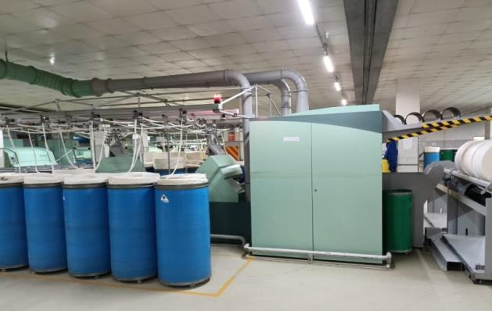
Omegalap
Name of Machine | Brand | Country of Origin | Total Qty.
Omegalap | Rieter | Switzerland | 1 set

Slide 20
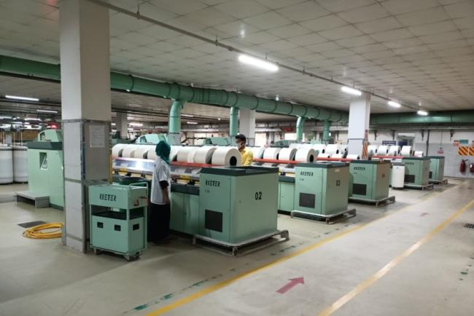
Comber
Name of Machine | Brand | Country of Origin | Total Qty.
Comber | Rieter | Switzerland | 6 set

Slide 21
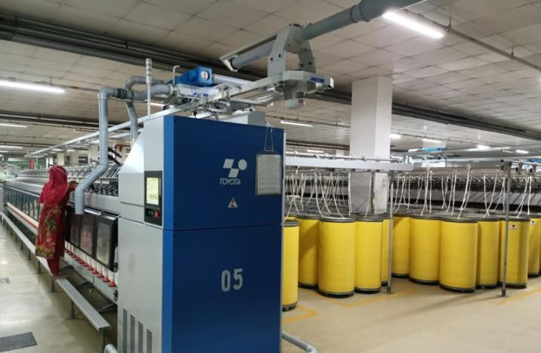
Simplex
Machine | Brand | Country of Origin | Qty
Simplex | Toyota | Japan | 5 Set

Slide 22
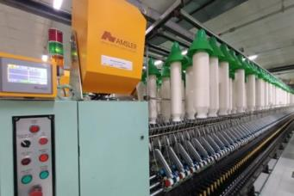
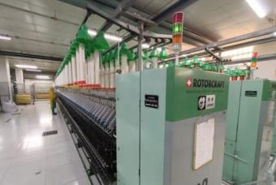
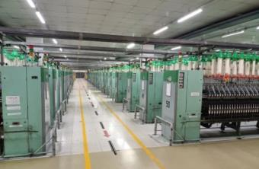
Ring Frame
Machine | Brand | Country of Origin | Qty
Ring Frame | Slub attachment (Amsler) | Switzerland | 5 Set
 | Compact attachment (Rotorcraft) | Switzerland | 5 Set
 | Jingwei | China | 50 Set

Slide 23
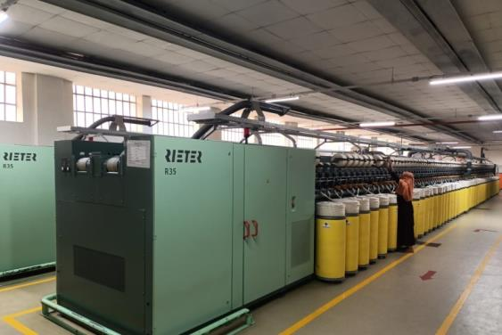
Rotor
Name of Machine | Brand | Country of Origin | Total Qty.
Rotor machine(200 Head) | Rieter | Switzerland | 2 Set
Sliver can(400 X 920 X 3.0 ) | Dante | Italy | 1000 pcs

Slide 24
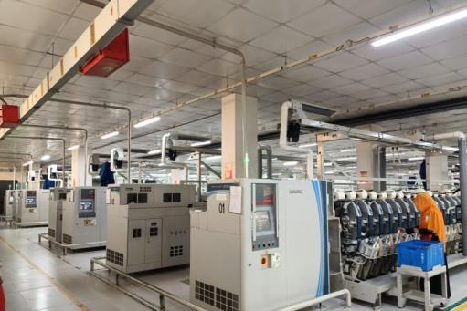
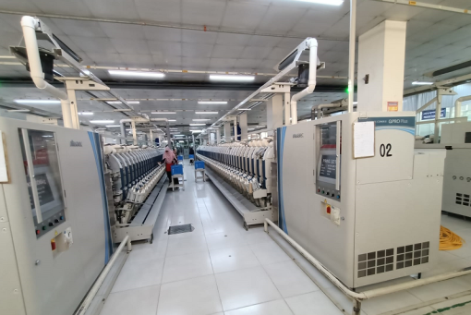
Autocone
Machine | Brand | Country of Origin | Qty
Autocone | Murata (Qpro Plus) | Japan | 7 Set

Slide 25
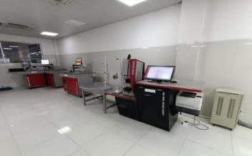
Quality Control M/C(S) and Equipment
Machine | Brand | Country of Origin | Qty
USTER HVI | USTER | Switzerland | 1 set
AFIS | USTER | Switzerland | 1 set
USTER TESTER | USTER | Switzerland | 1 set
USTER AUTOSORTER | USTER | Switzerland | 1 set
SMART BLOCK | MAG | INDIA | 1 set
OHURS BALANCE | MAG | INDIA | 1 set
FIBRO BLOCK | MAG | INDIA | 1 set
AUTO WINDER | MAG | INDIA | 1 set
COMPU TWIST | MAG | INDIA | 1 set
AUTO WARP | MAG | INDIA | 2 set
ELESTRETCH | MAG | INDIA | 1 set
DIGI MOISTURE | MAG | INDIA | 1 set
FORCE GAUGE | MAG | INDIA | 1 set
DIGITAL TROBOSCOPE |  | GERMANY | 1 set
Air Cooler |  | China | 1 set
AUTODYN II | MESDAN | ITALY | 1 set

Slide 26
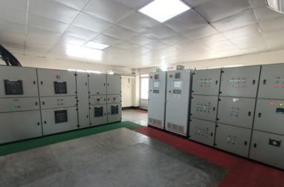
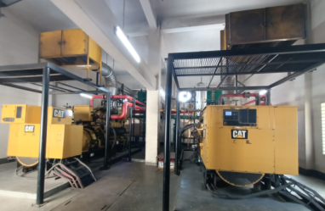
Generator
Machine Section | Name of Machine | Brand | Country of Origin | Total Qty.
Generator | Change Over | POWERBREEZE | BD | 1 set
Generator | Utility Panel | POWERBREEZE | BD | 1 set
Generator | Generator 24 KW | SDMO | French | 1 set
Generator | Cooling Tower |  | Malaysia | 2 set
Gas Generator | Caterpillar(1.5MW ) | Bangla cat | U.S.A | 1 set
Gas Generator | Caterpillar( 2.0MW) | Bangla cat | U.S.A | 1 set

Slide 27
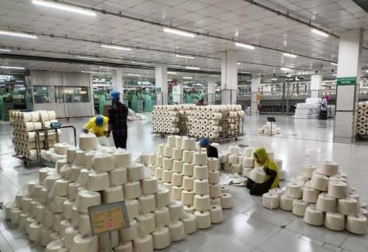
Gallery
Packing Area
Yarn Godown

Slide 28
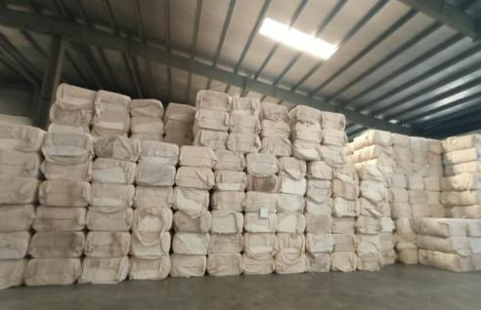
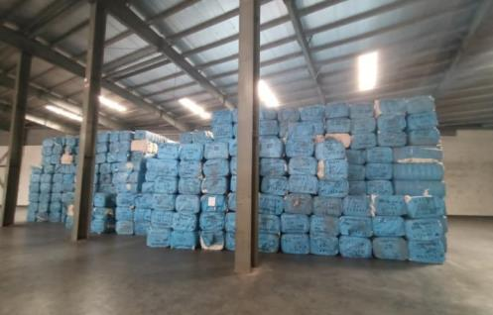
Gallery
Raw Cotton Godown
Raw Cotton Godown

Slide 29
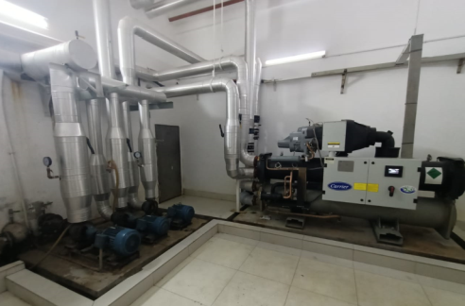
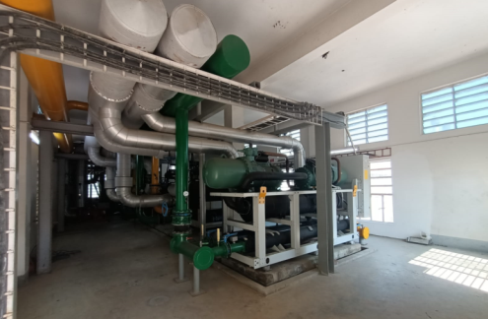
Gallery
Chiller (Carrier)
Chiller (Mitsubishi)

Slide 30
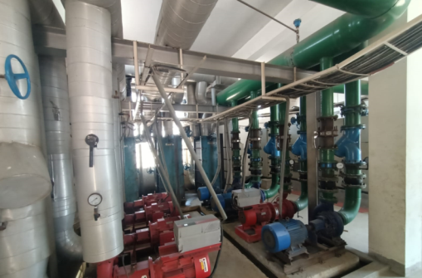
Gallery
Chiller Pump Room
Generator (Caterpillar)

Slide 31
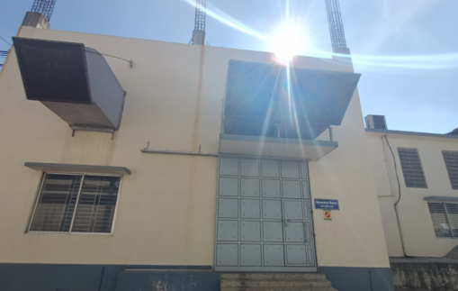
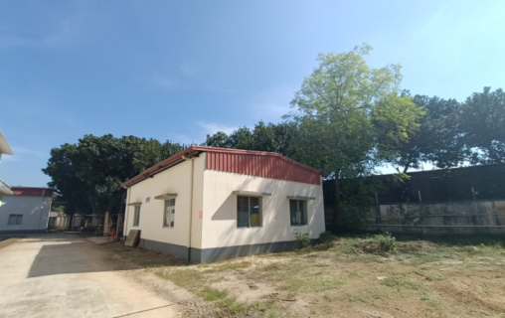
Gallery
Generator Building
Workshop Building

Slide 32
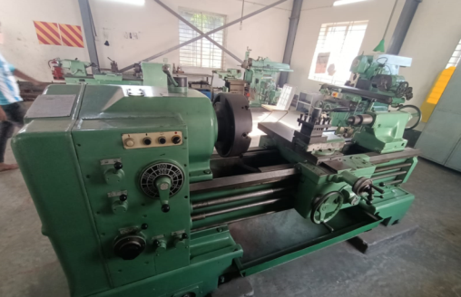
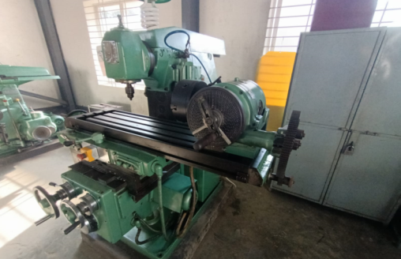
Gallery
Lathe M/C
Shaper M/C

Slide 33
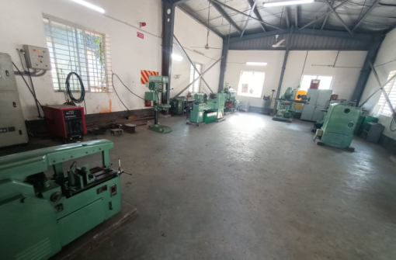
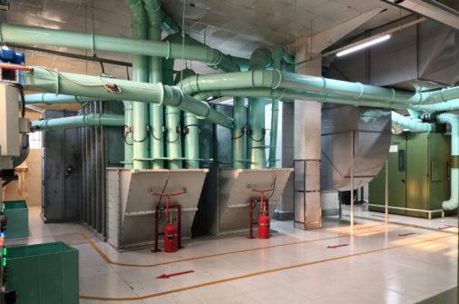
Gallery
Workshop
Filter A/C Plant

Slide 34
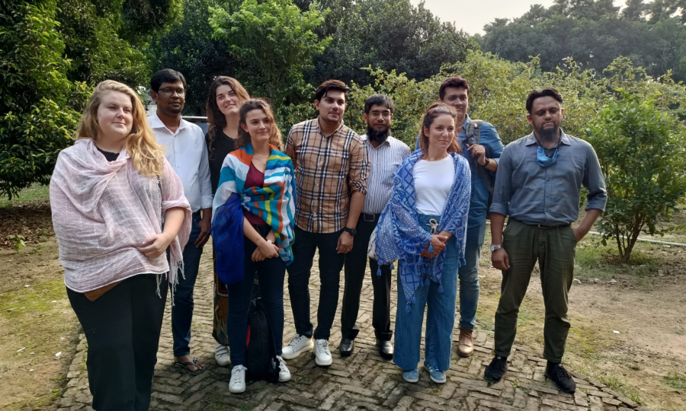
Gallery

Slide 35
Thank You

